Slide 1
Motivational intervention for family members living with a relative with a substance-related disorder
Cassandra Borges Bortolon
Psychologist, Specialist, MSc , PhD Health Science, Afinet Trustee

Slide 2
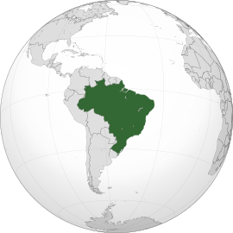
Introduction
Introduction
250.000.000
12.000.000
Estimated number of
psychoactive drug users
in the world.
Our population of affected family members is that over 28.000.000.

Slide 3
Introduction
Introduction
- People with drug use problem
- Global burden
Family problems

Slide 4
Aim
Aim
The aim of this study is to determine the effectiveness of the Motivational Intervention for families with inassertive behavior.
Participants
Participants
325 family members. They called a toll-free phone service to receive counseling and information on how to deal with a SMR, or to request information about treatment center.
Our methodology was developed for phone use and can be applied in digital and face-to-face contexts.

Slide 5
Method
Method
Motivational Intervention was based on:
- Stages of change
- Motivational Interview
- Telemedicine

Slide 6
2nd month > 4th month > 6th month > 12th month
Maintenance Stage
Action Stage II
Sixth session
Fifth session
Action Stage I
Fourth session
Preparation
Stage
Third session
Motivational
Stage
Second session
Understanding
First session
Psychoeducation

Slide 7
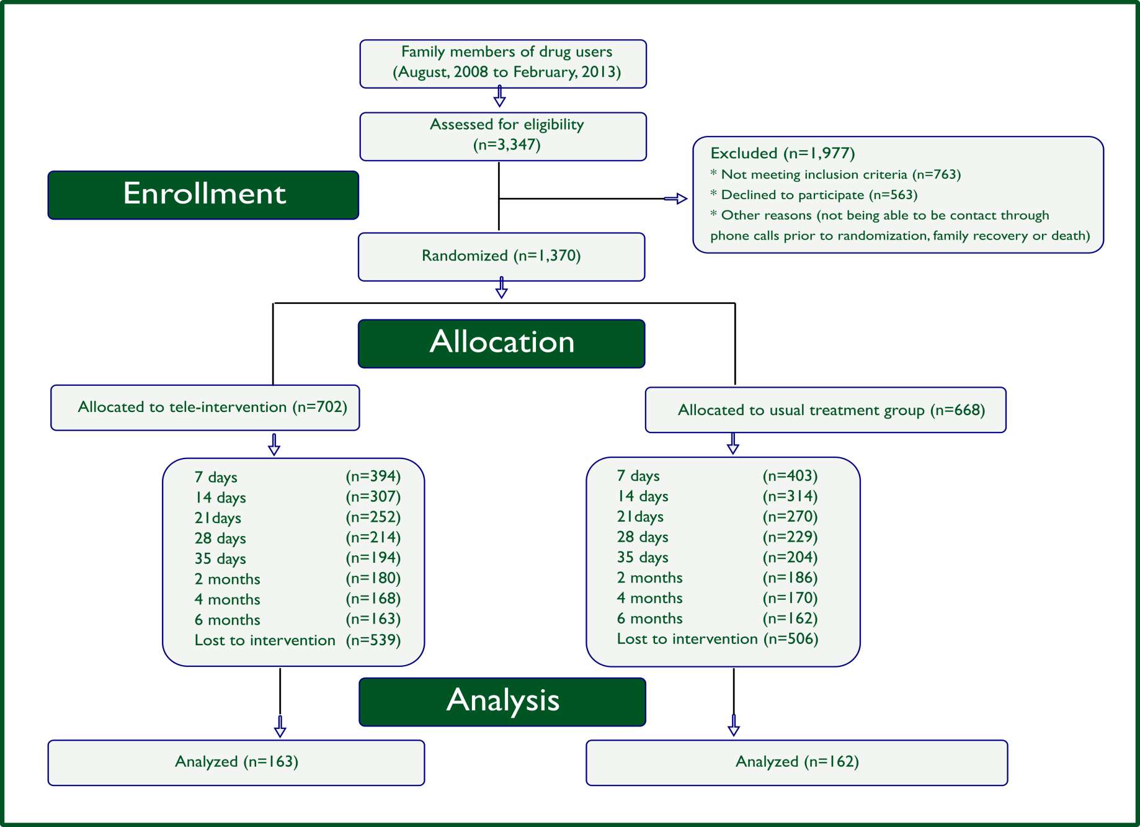
Flowchart
Flowchart
https://www.tandfonline.com/doi/abs/10.1080/10826084.2016.1223134?journalCode=isum20

Slide 8
Result
Result
After 6 months of follow-up, the family members of the Motivational Intervention were twice as likely to have modified their behavior from high to low inassertive when compared to the usual treatment.

Slide 9
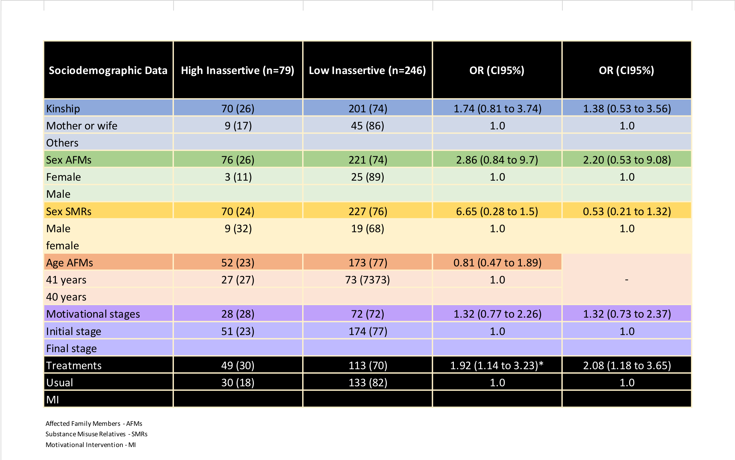
Odds Ratios (OR)
Odds Ratios (OR)

Slide 10
References
References
References
1
• Barros, H.M.T., Santos, V., Mazoni, C., Dantas, D.C.M. & Ferigolo, M. (2008). Neuroscience education for health profession undergraduatesin a call-center for drug abuse prevention. Drug and Alcohol Dependence, 98, 270-274.
• Bortolon CB, Moreira TC, Signor L, Guahyba BL, Figueiró LR, et al. (2017) Six-month outcomes of a randomized, motivational teleintervention for change in the codependent behavior of Family members of drug users. Subst Use Misuse 52 : 164-174.
• Bortolon CB (2016) Family functioning and health issues associated with codependency in families of drug users. Revista Ciência e Saúde Coletiva 21: 101-107.
• Bortolon CB, Barros HMT (2016). A dança da família na dependência química. IN: Poletto M, De Souza APL; Koller SH (Org.) Escola e educação. Práticas e reflexões, pp: 177-186.
• Bortolon, C., Machado, C. A. Ferigolo, M., Barros, H. M. T. (2013). Abordagem Motivacional para familiar de usuário de drogas por telefone: um estudo de caso. Contextos Clínicos, 6(2), 157-163. Retrieved from http://revistas.unisinos.br/index.php/contextosclinicos/article/view/ctc.2013.62.08. DOI: 10.4013/ctc.2013.62.08.
• Bortolon, C.B., Ferigolo, M., Grossi R., Kessler, F.H.P., Barros, H.M.T. (2010). Avaliação das crenças codependentes e dos estágios de mudança em familiares de usuários de drogas em um serviço de teleatendimento. Revista da AMRIGS, 54 (4), 432-436. Retrieved from http://www.amrigs.com.br/revista/54-04/013-639_avaliacao_das_crencas.pdf.
• Copello A. G., Velleman R. D. B., Templeton L. J. Family interventions in the treatment of alcohol and drug problems. Drug and Alcohol Review, 24, 369 – 385. 2005.
• Dear, G.; Roberts, C. The Holyoake Codependency Index: Investigation of the factor structure and psychometric properties. Psychological Reports,87, 991-1002, 2000.
http://www.unodc.org/lpo-brazil/pt/frontpage/2018/06/relatorio-mundial-drogas-2018.html
• Instituto Brasileiro de Geografia Estatística, 2018. https://www.ibge.gov.br/

Slide 11
References
References
2
• Laranjeira, R., Madruga, C.S., Pinsky, I., Caetano, R., Mitsuhiro, S.S., & Castello, G. (2012). II Levantamento Nacional de Alcool e Drogas (LENAD). Retrieved from ttp://inpad.org.br/wp-content/uploads/2014/
• Moreira, T.C., Figueiró, L.R., Fernandes, S., Justo, F.M., Dias, I.R., Barros, H.M.T & Ferigolo M. (2013). Quality of life of users of psychoactive substances, relatives, and non-users assessed using the WHOQOL-BREF. Ciência e Saúde Coletiva, 18(7), 1953-62.
• Orford, J, Padin, MFR, Canfield M, Sakiyama HMT, Laranjeira R, Mitsuhiro, SS. The burden experienced by Brazilian family members affected by their relatives’ alcohol or drug misuse. Drugs: Education, Prevention and Policy, 1-9, 2017.
• Orford, J., Velleman, R., Natera, G., Templeton, L., Copello, A. Addiction in the family is a major but negleget contribur to the global burden of adult ill-health. Social Science & Medicine. 78 (70-77), 2013.
• Prochaska, J.O., Diclemente, C.C. & Norcross, J.C. (1992). In search of how people change. Applications to addictive behaviors. American Psychologist, 47(9), 1102-1114.
• Rotunda R. West L. O’Farrel T. J. Enabling behavior in a clinical sample of alcohol-dependent clients and their partners. Journal of Substance Abuse Treatment 26, 269–276, 2004.
• Sakiyama, H.M.T., Padin, R.M.F.,Canfield, M., Laranjeira, R., Mitsuhiro, S.S. (2015). Family members affected by a relative’s substance misuse looking for social support: Who are they? Drug and alcohol Dependence, 147, 276-279.
• Smith, A.C., Gray, L.C. (2009). Telemedicine across the ages. The Medical Journal of Australia, 190 (12):719. Retrieved from https://www.mja.com.au/journal/2009/190/12/telemedicine-across-ages.
• Sola, V; H Sakiyama HMT; Padin MFR, Canfield, M; Bortolon, CB; Laranjeira R, Mitsuhiro, S.S. Measuring stress, coping, strain and hopefulness of Brazilian family members of substance misusers: Factor structure of a set of measures. Journal of Substance Use. 1-10, 2018.
• Velleman R. Templeton L. Alcohol, Drugs and the Family: Results from a Long-Running Research Programme within the UK. Eur Addict Res;9:103–112, 2003. DOI: 10.1159/000070978

Slide 12
Discussion points
Discussion points
The Motivational Intervention for family members living with SRD was studied to be applied by phone use. Could this intervention be used in other contexts?
In study published about Motivational Intervention for family members living with SRD relative, was mentioned about codependency. When you use ‘Inassertive’ in your presentation, do you use it similarly to ‘codependency’?

Slide 13
Team of Reseachers
Team of Reseachers
Cassandra Borges Bortolon ^{a,b}
Maria de Fátima Rato Padin ^{a,c}
Heloísa Praça Baptista ^{b}
Helena Maria Tannhauser Barros ^{b}
Ronaldo Ramos Laranjeira ^{a,c}
_{a}Department of Psychiatry, Federal University
São Paulo, São Paulo, Brazil.
_{b}Departament of Farmachology and Toxicology,
Federal University Healty of Science of Porto Alegre, Porto Alegre, Brazil
_{c}National Institute of Public Policy for Alcohol and Other Drugs, Brazil.

Slide 14
Thank you very much
Thank you very much
Contact: cassandra @ acurarte.com.br
ACURARTE Saúde e Ensino
Osvaldo Aranha 440-404
Porto Alegre, Rio Grande do Sul
ZipCode 90.035-190 - Brasil

